Slide 2
Who are we?
Derick Crelencia
Jeremy Felipe
William James Yoro
Jason Len

Slide 3
Difficulties of Group Work
Physical Location
Time

Slide 4
Solutions
Breaking up the work
individuals and small groups
GitHub and Discord
backed by e-mail or text
Making good use of class time, before and after class time

Slide 5



Our Project

Slide 6
Page Hierachy
Landing Page
Login Page → Login Page
Profile Page
Edit/Add
Browsing/Search/Filter of Profile
Looking for Game

Slide 7
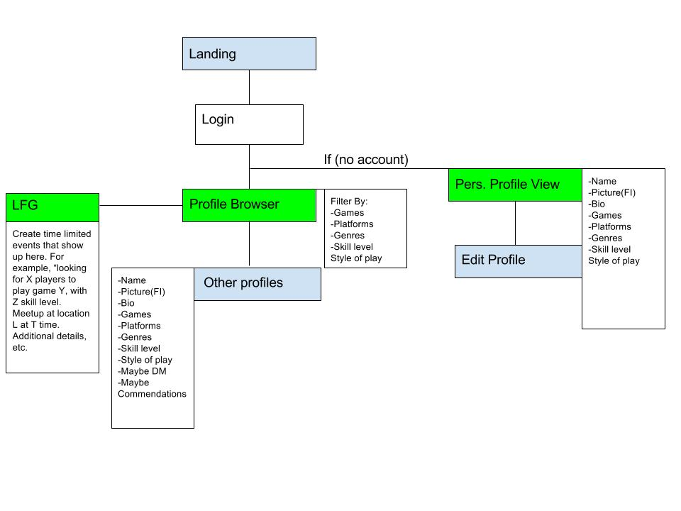
Graphical Hiearchy

Slide 8
Profile
Name
Picture(FI)
Bio
Games
Platforms
Genres
Skill level
Style of play
Maybe DM
Issues with harrasment
Maybe Commendations

Slide 9
Looking For Games (LGF)
Create time limited events that show up here. For example, “looking for X players to play game Y, with Z skill level. Meetup at location L at T time. Additional details, etc.”

Slide 10
Filter By:
Games
Platforms
Genres
Skill level
Style of play

Slide 11
Personal Profile
Name
Picture(FI)
Bio
Games
Platforms
Genres
Skill level
Style of play

